Slide 1
Module Seven: Hot topics in Service Computing - Cloud -

Slide 2
Topic 2: Cloud Service Models

Slide 3
Intended learning outcomes
After completing this topic, you will be able to:
Differentiate between different types of cloud service models
Be able to choose the appropriate cloud service model for different needs

Slide 4
Topic (2) Cloud service models
Introduction and evolution of cloud service models
Infrastructure as a Service (IAAS)
Platform as a Service (PAAS)
Software as a Service (SAAS)
More Services (XAAS)
Comparison between different models

Slide 5
Recall our cloud computing definition
Cloud computing is the delivery of different services through the Internet, which includes tools and applications like data storage, servers, databases, networking, and software.

Slide 6
different services available in the cloud
Access to physical servers, virtual servers, storage, networking - Infrastructure
Access to platforms for developing, running, maintaining and managing applications - Platform
Access to application software – Software

Slide 7
Cloud services
Cloud services are infrastructure, platforms, or software that are hosted by third-party providers and made available to users through the internet.

Slide 8
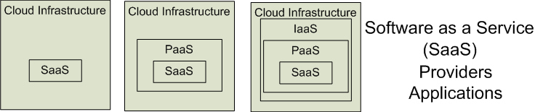

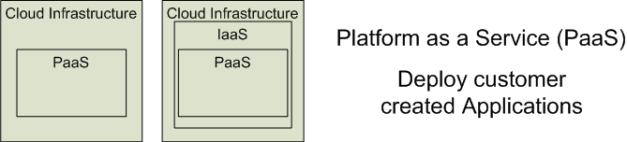

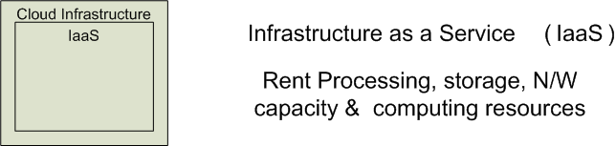


Cloud Service Models
Software as a Service (SaaS)
Platform as a Service (PaaS)
Infrastructure as a Service (IaaS)
SalesForce CRM
LotusLive
Google App Engine

Slide 9
Cloud service models
IaaS – Infrastructure
PaaS – Platform
SaaS – Software
as a Service

Slide 10
'… as a service’ (1)
refers to the way IT assets are consumed
It also describes the essential difference between cloud computing and traditional IT

Slide 11
'… as a service’ (2)
In traditional IT, an organization consumes IT assets - hardware, system software, development tools, applications - by purchasing them, installing them, managing them and maintaining them in its own on-premises data center.

Slide 12
'… as a service’ (3)
In cloud computing, the cloud service provider owns, manages and maintains the assets; the customer consumes them via an Internet connection, and pays for them on a subscription or pay-as-you-go basis.
There are three main types of as-a-Service solutions:
IaaS
PaaS
SaaS

Slide 13
'… as a service’ (4)
The main advantage of IaaS, PaaS, SaaS or any 'as a service' solution is economic
A customer can access and scale the IT capabilities it needs without the expense and overhead of purchasing and maintaining everything in its own data center.
But there are additional advantages specific to each of these solutions.

Slide 14
IaaS, PaaS, SaaS (1)
IaaS - infrastructure as a service - on-demand access to cloud-hosted physical and virtual servers, storage and networking - the backend IT infrastructure for running applications and workloads in the cloud
PaaS - platform as a service - on-demand access to a complete, ready-to-use, cloud-hosted platform for developing, running, maintaining and managing applications
SaaS - software as a service - on-demand access to ready-to-use, cloud-hosted application software

Slide 15
IaaS, PaaS, SaaS (2)
IaaS, PaaS and SaaS are not mutually exclusive. Many mid-sized businesses use more than one, and most large enterprises use all three
Each cloud service comes with its own set of advantages that can cater to various business requirements
We require a clear understanding of these cloud models to find out which one can work the best for specific needs of users
Let us understand each of the models and find out their merits

Slide 16
Evolution of cloud service models
IaaS can be thought of as the original 'as a service' offering
Every major cloud service provider - Amazon Web Services, Google Cloud, IBM Cloud, Microsoft Azure - began by offering some form of IaaS

Slide 17
Infrastructure as a Service (IAAS)

Slide 18
Infrastructure as a Service (IAAS)
The virtual delivery of computing resources in the form of hardware, networking, and storage services
Infrastructure is hosted by third-party providers and made available to users through the internet
Rather than buying and installing the required resources in their own data center, companies rent these resources as needed

Slide 19
What is infrastructure
Servers
Storage capacity
Networking resources

Slide 20
How infrastructure is provided
The cloud service provider hosts, manages and maintains the hardware and computing resources in its own data centers.
Customers can provision, configure and operate the servers and infrastructure resources via a graphical dashboard, or programmatically through application programming interfaces (APIs)
Typically IaaS customers can choose between virtual machines (VMs) hosted on
shared physical hardware
bare metal servers on dedicated (unshared) physical hardware

Slide 21
IaaS characteristics
Users are provided with virtualized hardware and storage on top of which they can build their infrastructure
Dynamic scaling
Self scaling
Alterable cost – utility pricing model
Pay as you go
Ability to provide single hardware to many users
The costs are less due to the share of infrastructure

Slide 22
User activities in IaaS
Configures the infrastructure
Setups the infrastructure
Installs, manages and monitors any required software

Slide 23
Typical level of control granted to cloud user in IaaS
Full administrative

Slide 24
Cloud provider activities in IaaS
Manages and provisions the storage
Physical processing, hosting and networking
Monitors usage by the consumer of cloud

Slide 25
Who manages what in IaaS model
A cloud service provider
manages the infrastructure for the user
The actual servers, network, virtualization, and data storage
has the responsibility of taking care of
Outages
Repairs
Hardware issues
The user
has access through an API or dashboard, and essentially rents the infrastructure
manages things like the operating system, apps, and middleware

Slide 26
Vendors of IaaS
Amazon
Gogrid
RACKSPACE
IBM BlueHouse
Linode
VMWare

Slide 27
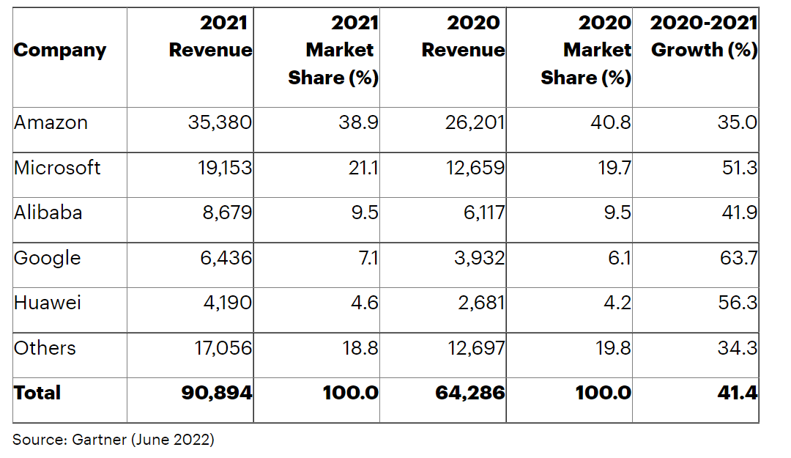
Worldwide IaaS Public Cloud Services Market Share, 2020-2021 (Millions of U.S. Dollars)

Slide 28
IaaS Example - Amazon Web Services
A public cloud that offers subscribers
Access to virtual servers for product deployment
Cloud storage
Tools for development, testing, and analytics
The application provides a ready-to-use environment to develop and test the product and offers the full cloud infrastructure for its deployment and maintenance

Slide 29
AWS Free Usage Tier
Free Amazon EC2 (elastic compute) Micro Instance for a year
Includes free usage tier for:
Amazon S3
Amazon Elastic Block Store
Amazon Elastic Load Balancing
AWS data transfer
Free usage of AWS Management Console to build and manage applications on AWS
AWS’s free usage tier can be used for anything you want to run in the cloud:
Launch new applications
Test existing applications in the cloud
Gain hands-on experience with AWS

Slide 30
Amazon Elastic Compute (EC2) Instances
A virtual server is referred to as an Amazon EC2 instance
Amazon Elastic Compute Cloud (Amazon EC2) is a component of AWS and central to many cloud-based applications
A micro Amazon EC2 instance can be launched in the free usage tier
Micro instances provide a small amount of consistent CPU resources and allow o burst CPU capacity when additional cycles are available (613 MB of memory, up to 2 ECUs (for short periodic bursts), EBS storage only, 32-bit or 64-bit platform)
A micro instance is well suited for lower throughput applications and web sites that consume significant compute cycles only occasionally
To request an Amazon EC2 instance, you use the Request Instances wizard or the Quick Launch wizard to specify an Amazon Machine Image (AMI)
An AMI contains all the information that AWS needs to create the instance
Amazon EC2 instances can also be launched automatically when you deploy a web application using AWS Elastic Beanstalk

Slide 31
Amazon Simple Storage Service (S3)
Amazon S3 is storage for the Internet
Amazon S3 provides a simple web services interface that can be used to store and retrieve any amount of data, at any time, from anywhere on the web
It gives any developer access to the same highly scalable, reliable, secure, fast, inexpensive infrastructure that Amazon uses to run its own global network of web sites
S3 allows to write, read, and delete objects containing from 1 byte to 5 terabytes of data each. The number of objects you can store is unlimited
Each object is stored in a region-specific bucket and retrieved via a unique, developer-assigned key
Data stored in Amazon S3 is secure by default
Only bucket and object owners have access to the Amazon S3 resources they create
Amazon S3 supports multiple access control mechanisms, as well as encryption for both secure transit and secure storage on disk
Typical use cases
Content storage and distribution
Storage for data analysis
Backup, archiving and disaster recovery

Slide 32
IaaS Example - IBM Infrastructure
IBM uses its in-house services to store the data of infrastructure users, enabling remote data access via Cloud computing
IBM servers support AI, blockchain, and the Internet of Things
The infrastructure also provides Cloud storage and virtual development environments, enabled on the subscription basis

Slide 33
IaaS Example - Google Cloud Infrastructure
A large network of international servers that provides users access to remote Cloud data centers.
Companies can store their information in Asia, Europe, Latin America, which minimizes the risk of a security breach

Slide 34
IaaS use cases (1)
Disaster recovery
Instead of setting up redundant servers in multiple locations, IaaS can deploy its disaster recovery solution to the cloud provider's existing geographically-dispersed infrastructure

Slide 35
IaaS use cases (2)
E-commerce
IaaS is an excellent option for online retailers that frequently see spikes in traffic
The ability to scale up during periods of high demand and high-quality security are essential in today’s 24-7 retail industry

Slide 36
IaaS use cases (3)
Applications that work with huge volumes of data
Internet of Things (IoT)
event processing
artificial intelligence (AI)
IaaS makes it easier to set up and scale up data storage and computing resources

Slide 37
IaaS use cases (4)
Startups
Startups can't afford to sink capital into on-premises IT infrastructure
IaaS gives them access to enterprise-class data center capabilities without the up-front investment in hardware and management overhead

Slide 38
IaaS use cases (5)
Software development
With IaaS, the infrastructure for testing and development environments can be set up much more quickly than on-premises.
However, this use case is better suited to PaaS

Slide 39
Discussion
Suppose a large organization wants to deliver a customer relationship management (CRM) application to its sales team.
CRM software connects all the data from sales leads and customers. It consolidates all communications (form fills, calls, emails, text messages, and meetings), documents, quotes, purchases, and tasks associated with each lead and client.
Can they choose an IaaS model?

Slide 40

Multiple Choice(single)
Points: 1
Suppose a large organization wants to deliver a customer relationship management (CRM) application to its sales team.
(*) CRM software connects all the data from sales leads and customers. It consolidates all communications (form fills, calls, emails, text messages, and meetings), documents, quotes, purchases, and tasks associated with each lead and client.
Can they choose an IaaS model?
A
YES
B
NO
Submit

Slide 41
Discussion
If the company chooses an IaaS model,
what will be their own responsibility?
what will be provided by the cloud provider?

Slide 42
Open Question
Points: 10
If the company chooses an IaaS model, what will be their own responsibility and what will be provided by the cloud provider?
They can build out backend IT infrastructure on the cloud using IaaS, and use it to build its own development platform and application.
The organization's IT team would have complete control over operating systems and server configurations, but also bear the burden of managing and maintaining them, along with the development platform and applications that run on them.
Open Question is only supported on Version 2.0 or newer.
Answer

Slide 43
Platform as a Service (PAAS)

Slide 44
Platform as a Service (PAAS) - 1
Platform as a Service is software that provides access to development tools, APIs, and deployment instruments
Users receive access to virtual development environments and Cloud storage, where they can build, test, and run applications.

Slide 45
Platform as a Service (PAAS) - 2
Platform is hosted by third-party providers and made available to users through the internet
PaaS providers host the hardware and software on their infrastructure, thereby releasing customers from any obligation to install in-house hardware and software to develop or run a new application

Slide 46
Platform as a Service (PAAS) - 3
The consumer does not manage or control the underlying cloud infrastructure including network, servers, operating systems, or storage
The consumer has control over the deployed applications and possibly configuration settings for the application-hosting environment

Slide 47
What is platform
Cloud-based platform for developing, running, managing applications
hardware and software
servers for development, testing and deployment
operating system (OS) software
storage, networking, databases, middleware, runtimes, frameworks,
development tools
…

Slide 48
How is platform provided
PaaS provides a virtual runtime environment through which users can acquire space to develop and test various applications.
The cloud services provider hosts, manages and maintains all the hardware and software included in the platform as well as related services for security, operating system and software upgrades, backups and more.
Users access the PaaS through a graphical user interface (GUI), where development teams can collaborate on all their work across the entire application lifecycle including coding, integration, testing, delivery, deployment, and feedback.

Slide 49
PaaS characteristics
Users are provided with a platform for developing applications hosted in the Cloud
Services to develop, test, deploy, host and maintain applications
Users can use Web based user interface creation tools help to modify, create, deploy and test different UI scenarios
Same development application could be utilized by many users
Support for development team collaboration
Tools available to handle billing and subscription management
It consumes cloud infrastructure

Slide 50
User activities in PaaS
Tests cloud based solutions and cloud services
Develops cloud based solutions and cloud services
Manages cloud based solutions and cloud services
Deploys cloud based solutions and cloud services

Slide 51
Typical level of control granted to cloud user in PaaS
Limited administrative

Slide 52
Cloud provider activities in PaaS
Pre-configure platform
Provision underlying infrastructure, middleware and other required IT resources
Monitor usage by a consumer of the cloud

Slide 53
Who manages what in PaaS model
PaaS means the hardware and an application-software platform are provided and managed by an outside cloud service provider
The user handles the apps running on top of the platform and the data the app relies on.

Slide 54
Vendors of PaaS
Google AppEngine
Microsoft Azure
Amazon AWS Elastic Beanstalk
Yahoo developer Network
…

Slide 55
PaaS examples - AWS Elastic Beanstalk
A web platform for software deployment and management, powered by the AWS Cloud
Users upload their applications to the service, and it automatically monitors the performance, load capacity, and checks for deployment errors

Slide 56
PaaS examples - Apache Stratos
The Cloud computing platform that helps run Apache Tomcat, PHP, and MySQL applications
It can be extended to support many more environments on all major cloud infrastructures.
It provides users with ready-to-use tools for database development and testing, performance monitoring, integration, and billing.

Slide 57
PaaS use cases (1)
API development and management
With its built-in frameworks, PaaS makes it easier for teams to develop, run, manage and secure APIs for sharing data and functionality between applications.
API - Application Programming Interface
mechanisms that enable two software components to communicate with each other using a set of definitions and protocols
Example
the weather bureau’s software system contains daily weather data
the weather app on your phone “talks” to this system via APIs and shows you daily weather updates on your phone

Slide 58
PaaS use cases (2)
Internet of Things (IoT)
PaaS supports a range of programming languages (Java, Python, Swift, etc.), tools and application environments used for IoT application development and real-time processing of data from IoT devices.
IoT
the network of physical objects—“things”—that are embedded with sensors, software, and other technologies for the purpose of connecting and exchanging data with other devices and systems over the internet
These devices range from ordinary household objects to sophisticated industrial tools.

Slide 59
PaaS use cases (3)
Agile development and DevOps
PaaS solutions typically cover all the requirements of a DevOps toolchain, and provide built-in automation to support continuous integration and continuous delivery (CI/CD).
DevOps
a set of practices that combines software development and IT operations
It aims to shorten the systems development life cycle and provide continuous delivery with high software quality. DevOps is complementary with Agile software development

Slide 60
PaaS use cases (4)
Cloud-native development and hybrid cloud strategy
PaaS solutions support cloud-native development technologies - microservices, containers, Kubernetes, serverless computing
A cloud-native application is a program that is designed for a cloud computing architecture

Slide 61
Discussion
Suppose a large organization wants to deliver a customer relationship management (CRM) application to its sales team.
CRM software connects all the data from sales leads and customers. It consolidates all communications (form fills, calls, emails, text messages, and meetings), documents, quotes, purchases, and tasks associated with each lead and client.
Can they choose a PaaS model?

Slide 62
Multiple Choice(single)
Points: 1
Suppose a large organization wants to deliver a customer relationship management (CRM) application to its sales team.
(*) CRM software connects all the data from sales leads and customers. It consolidates all communications (form fills, calls, emails, text messages, and meetings), documents, quotes, purchases, and tasks associated with each lead and client.
Can they choose a PaaS model?
A
YES
B
NO
Submit

Slide 63
Discussion
If the company chooses a PaaS model,
what will be their own responsibility?
what will be provided by the cloud provider?

Slide 64
Open Question
Points: 10
If the company chooses a PaaS model, what will be their own responsibility and what will be provided by the cloud provider?
They can choose a PaaS solution and build a custom CRM application using the platform provided in the cloud.
The company would offload management of infrastructure and application development resources to the cloud service provider.
The customer would retain complete control over application features, but it would also assume responsibility for managing the application and associated data.
Open Question is only supported on Version 2.0 or newer.
Answer

Slide 65
Software as a Service (SAAS)

Slide 66
Software as a Service (SAAS)
Software is hosted by third-party providers and made available to users through the internet
(SaaS) is a software licensing and delivery model
A web platform that provides users access to cloud computing on a subscription basis
Instead of purchasing the solution one time, as if it would be a product, the software is delivered continuously — like a service.

Slide 67
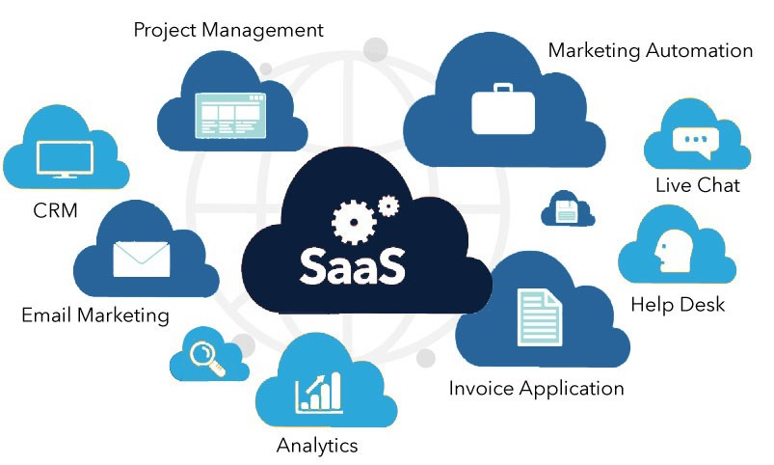
What is software
web applications or mobile apps that users can access via a web browser

Slide 68
How is software provided
SaaS is a service that delivers a software application—which the cloud service provider manages—to its users
Software updates, bug fixes, and other general software maintenance are taken care of for the user
SaaS apps are web applications or mobile apps that users can access via a web browser
Users connect to the cloud applications via a dashboard or API
SaaS eliminates the need to have an app installed locally on each individual user’s computer
allowing team access to the software

Slide 69
SaaS characteristics
Centralized Hosting /Delivery
Users are provided with applications that are accessible anytime and from anywhere
These applications are provided in one-to-many mechanism
UI powered by “thin client” applications
SLA – Service Level Agreement
Stateless
Loosely coupled
Modular

Slide 70
User activities in SaaS
Uses cloud service
Configures cloud service

Slide 71
Typical level of control granted to cloud user in SaaS
Usage
Usage-related configuration

Slide 72
Cloud provider activities in SaaS
Manage, maintain and implement cloud service
Monitor usage by the consumer of cloud

Slide 73
Who manages what in SaaS model
The application and all of the infrastructure required to deliver it - servers, storage, networking, middleware, application software, data storage - are hosted and managed by the SaaS vendor
The vendor also manages all upgrades and patches to the software, usually invisibly to customers
Customers can add more users and data storage on demand at additional cost

Slide 74
Vendors of SaaS
Salesforce.com,
Microsoft Office 365
Google documents,
Clarizen.com,
Gmail,
Hotmail,
Quicken online,
Netsuite,

Slide 75
Examples of SaaS - Microsoft Office 365
The series of web services that provide business owners and individuals with access to Microsoft Office main tools directly from their browsers
Users can access Microsoft editing tools, business email, communication instruments, and documentation software

Slide 76
Examples of SaaS - Salesforce
The most popular CRM on the market that unites marketing, communication, e-commerce
Business owners can keep track of their sales, client relations, communications, and relevant tasks from any device
Salesforce can be integrated into the website — the information about incoming leads will be sent to the platform automatically

Slide 77
SaaS use cases (1)
Today, just about any personal or employee productivity application is available as SaaS
If an end user or organization can find a SaaS solution with the required functionality, in most cases it will provide a significantly simpler, more scalable and more cost-effective alternative to on-premises software.
Many applications designed originally for the desktop (e.g., Adobe Creative Suite) are now available as SaaS (e.g., Adobe Creative Cloud).

Slide 78
SaaS use cases (2)
SaaS applications people use every day in their personal lives
email
social media
cloud file storage solutions
…

Slide 79
SaaS use cases (3)
Business or enterprise SaaS solutions
customer relationship management software
marketing software
workflow management
collaboration and messaging
graphics
…

Slide 80
Discussion
Suppose a large organization wants to deliver a customer relationship management (CRM) application to its sales team.
CRM software connects all the data from sales leads and customers. It consolidates all communications (form fills, calls, emails, text messages, and meetings), documents, quotes, purchases, and tasks associated with each lead and client.
Can they choose a SaaS model?

Slide 81
Multiple Choice(single)
Points: 1
Suppose a large organization wants to deliver a customer relationship management (CRM) application to its sales team.
(*) CRM software connects all the data from sales leads and customers. It consolidates all communications (form fills, calls, emails, text messages, and meetings), documents, quotes, purchases, and tasks associated with each lead and client.
Can they choose a SaaS model?
A
YES
B
NO
Submit

Slide 82
Discussion
If the company chooses a SaaS model,
what will be their own responsibility?
what will be provided by the cloud provider?

Slide 83
Open Question
Points: 10
If the company chooses a SaaS model, what will be their own responsibility and what will be provided by the cloud provider?
They can choose a SaaS CRM solution, offloading all day-to-day management to the third-party vendor, but also giving up all control over features and functionality, data storage, user access and security.
Open Question is only supported on Version 2.0 or newer.
Answer

Slide 84
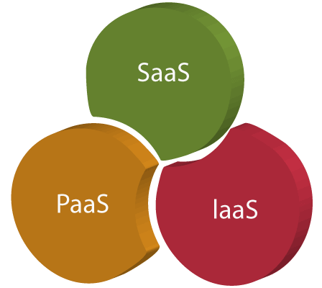
… as a service

Slide 85
… as a service
Traditional computing
Cloud computing
Computing resources are products
Own and managed internally by organizations and individuals
Computing resources become services

Slide 86
… as a service
Refers to the way IT assets are consumed in cloud computing
the cloud service provider owns, manages and maintains the assets
the customer consumes them via an Internet connection, and pays for them on a subscription or pay-as-you-go basis
There are three main types of as-a-Service solutions
IaaS
PaaS
SaaS
But there are other as-a-Service solutions available as well
XaaS

Slide 87
XaaS
There are other cloud service models described as XaaS
X represents Anything/Everything
Anything as a Service
Everything as a Service
X will be replaced with a letter describing the resource available as a service

Slide 88
Other cloud service models
Network as a service (NaaS)
Backup as a service (BaaS)
Database as a service (DBaaS)
Communications as a service (CaaS)
Storage as a service (STaaS)
Desktop as as service (DaaS)
Business Process as a Service (BPaaS)
Function as a Service (FaaS)
Artificial Intelligence as a Service (AIaaS)
…

Slide 89
AIaaS
A model of delivering artificial intelligence (AI) capabilities and services through the cloud as a subscription-based service
Allows businesses and developers to access powerful AI tools and services without having to invest inexpensive hardware and software infrastructure

Slide 90
AIaaS
Users can access a range of pre-built AI models and tools, such as natural language processing, computer vision, and predictive analytics, as well as customizable machine learning and deep learning algorithms
These services can be used to develop applications, automate business processes, and gain insight from large amounts of data

Slide 91
AIaaS Example – OpenAI API
ChatGPT and Whisper models are available on OpenAI API, giving developers access to language and speech-to-text capabilities and integrate them in their own applications
Developers can use Whisper large-v2 model in the API
ChatGPT API users have the option to choose dedicated capacity for deeper control over the models
https://openai.com/blog/openai-api
https://openai.com/blog/introducing-chatgpt-and-whisper-apis

Slide 92
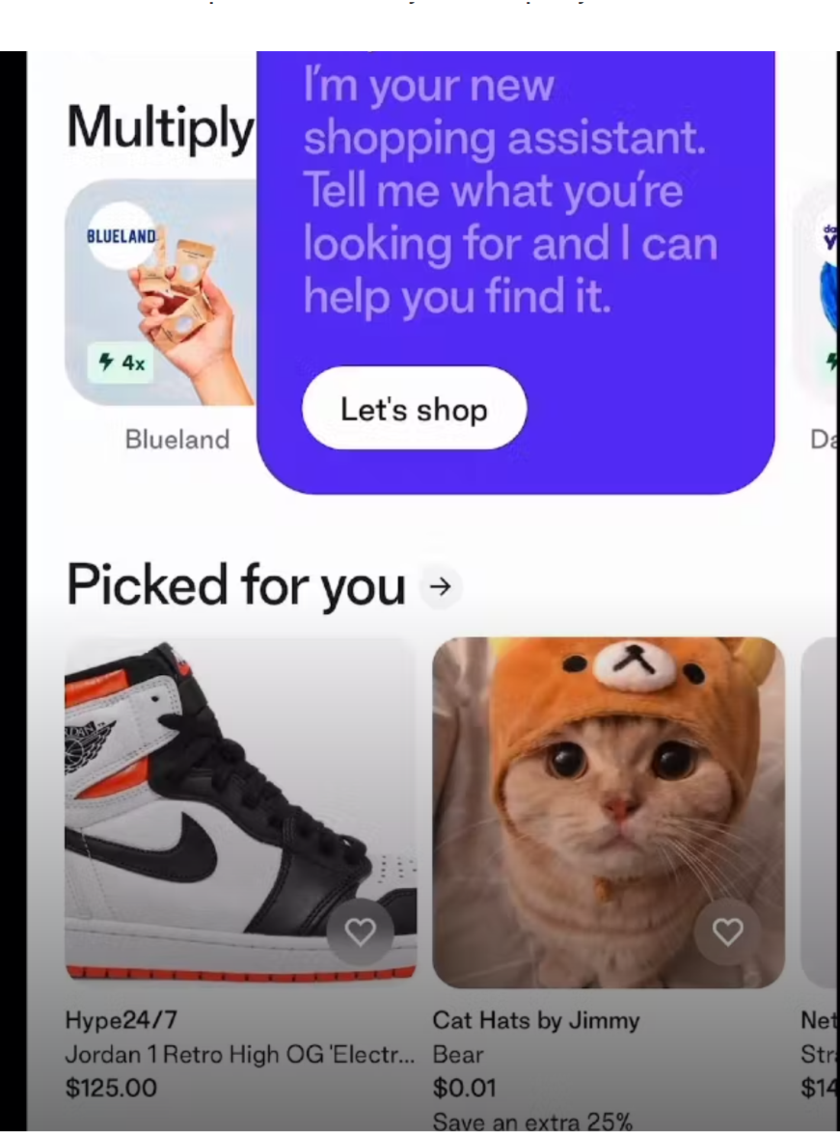
ChatGPT API use case example
Shop, Shopify’s consumer app, is used by 100 million shoppers to find and engage with the products and brands they love

Slide 93
ChatGPT API use case example
ChatGPT API is used to power Shop’s new shopping assistant
When shoppers search for products, the shopping assistant makes personalized recommendations based on their requests

Slide 94
ChatGPT API use case example
Shop’s new AI-powered shopping assistant will streamline in-app shopping by scanning millions of products to quickly find what buyers are looking for—or help them discover something new

Slide 95
More use case examples
https://openai.com/blog/introducing-chatgpt-and-whisper-apis

Slide 96
Comparison between the cloud service models
Which model should the business choose?

Slide 97
SaaS vs PaaS vs IaaS (1)
SaaS, Paas, IaaS are not mutually exclusive; most organizations use more than one, and many larger organizations today use all three, often in combination with traditional IT

Slide 98
SaaS vs PaaS vs IaaS (2)
The as-a-service solution a customer chooses depends first on the functionality the customer requires, and the expertise it has on staff
For example, an organization without the in-house IT expertise for configuring and operating remote servers isn't well matched to IaaS
An organization without a development team has no need for PaaS

Slide 99
SaaS vs PaaS vs IaaS (3)
In some cases, any of the three 'as-a-service' models will offer a viable solution
In these cases, organizations typically compare the alternatives based on the management ease they offer, vs. the control they give up

Slide 100
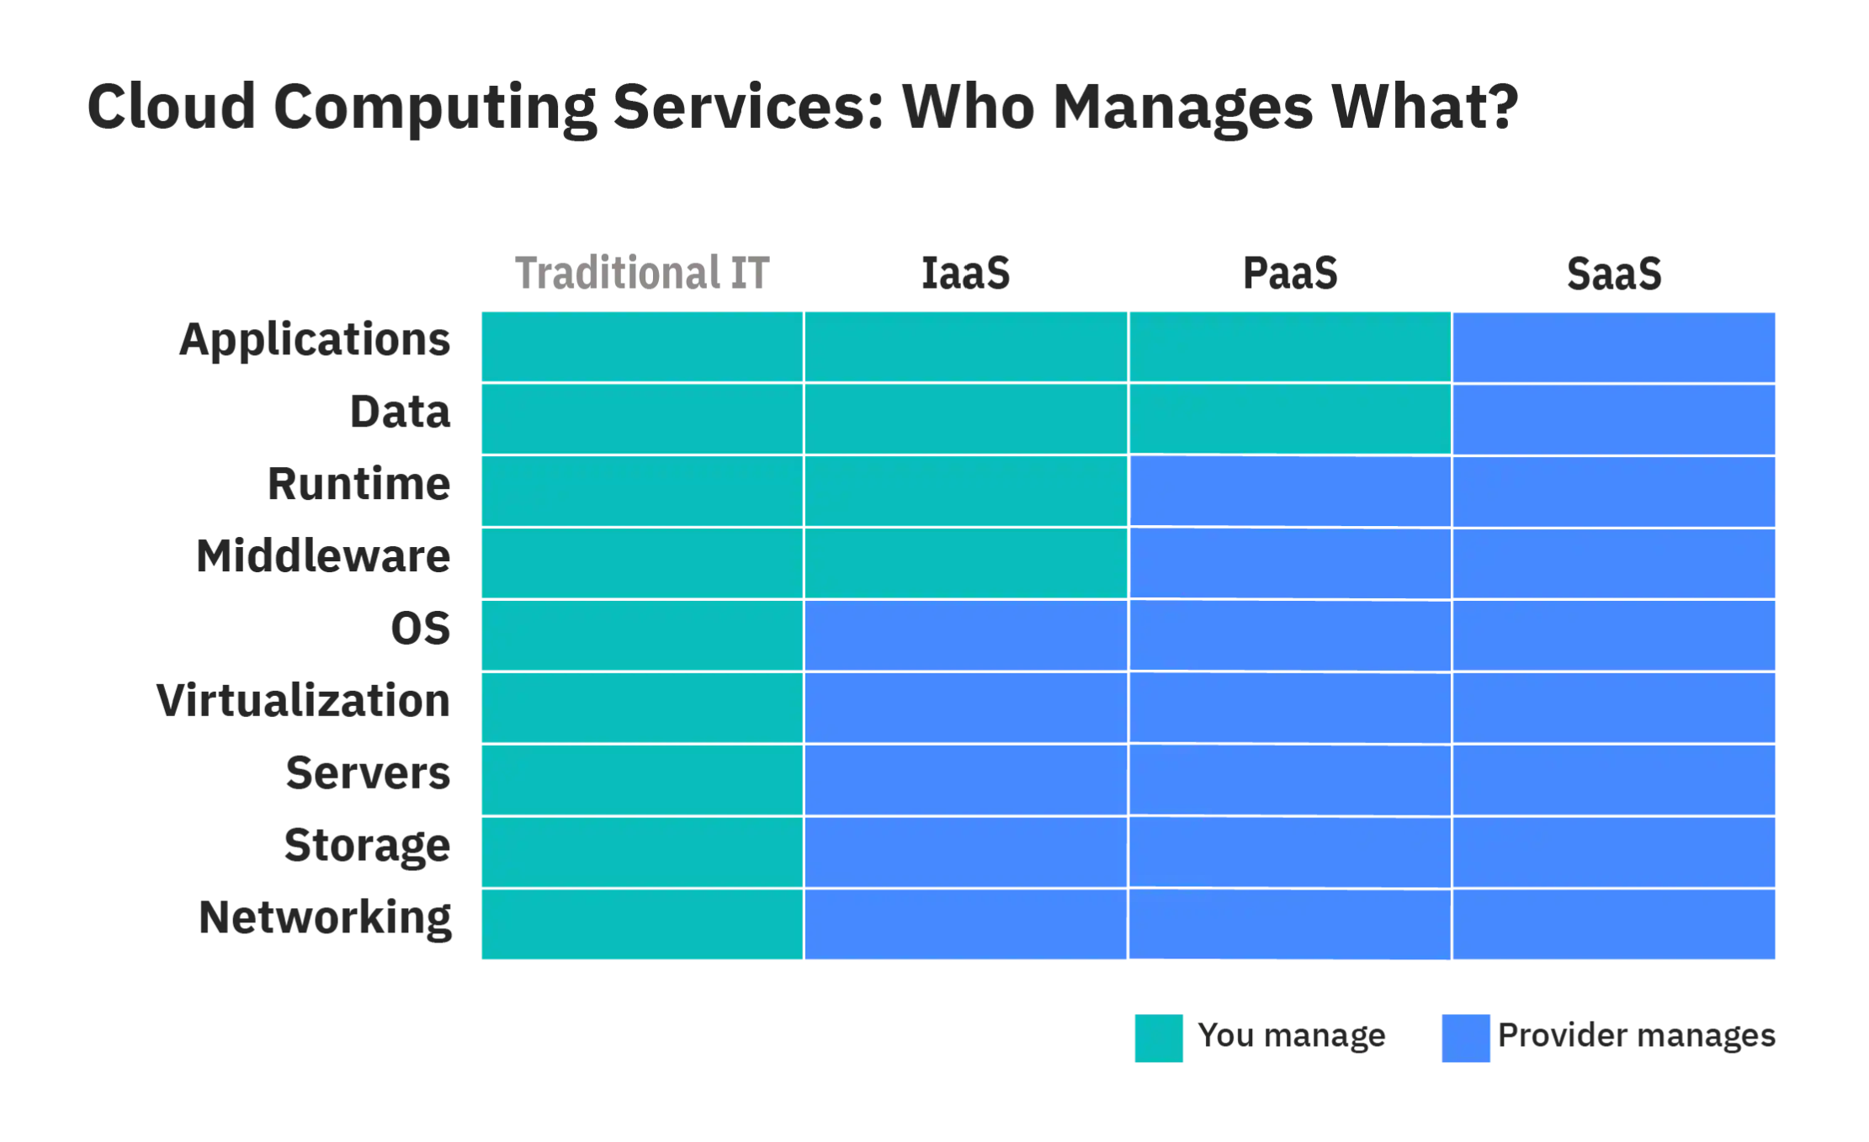
Management ease vs complete control

Slide 101
Review

Slide 102
Multiple Choice(single)
Points: 1
Which one of the following provides the resources or services such as virtual infrastructure, virtual machines, virtual storage, and several other hardware assets?
A
IaaS
B
PaaS
C
SaaS
Submit

Slide 103
Discussion
In the IaaS (Infrastructure as a service) service provider maintains all the infrastructure, while the client is responsible for several other deployment aspects.

Slide 104
Azure is a public cloud computing platform—with solutions including Infrastructure as a Service (IaaS), Platform as a Service (PaaS), and Software as a Service (SaaS) that can be used for services such as analytics, virtual computing, storage, networking, and much more.
It has more than 200 products and cloud services
For the project you are currently working on, you plan to provide Infrastructure as a Service (IaaS) resources in Azure. Which resource is an example of IaaS?

Slide 105
Multiple Choice(single)
Points: 1
Remark
Azure is a public cloud computing platform—with solutions including Infrastructure as a Service (IaaS), Platform as a Service (PaaS), and Software as a Service (SaaS) that can be used for services such as analytics, virtual computing, storage, networking, and much more.
It has more than 200 products and cloud services
For the project you are currently working on, you plan to provide Infrastructure as a Service (IaaS) resources in Azure. Which resource is an example of IaaS?
We can control hardware using IaaS resources
A
an Azure web app
B
an Azure virtual machine
C
an Azure logic app
D
an Azure SQL database
Submit
Text\Image\Formula are allowed and all the content should be placed in this area

Slide 106
Multiple Choice(single)
Points: 1
Which one of the following can be considered as the most complete cloud computing service model?
A
IaaS – Infrastructure as a Service
B
PaaS - Platform as a Service
C
SaaS – Software as a Service
Submit

Slide 107
Discussion
The most complete cloud computing service model must contain the computing hardware and software, as well as the solution itself.
Hence the SaaS model has all these features.

Slide 108
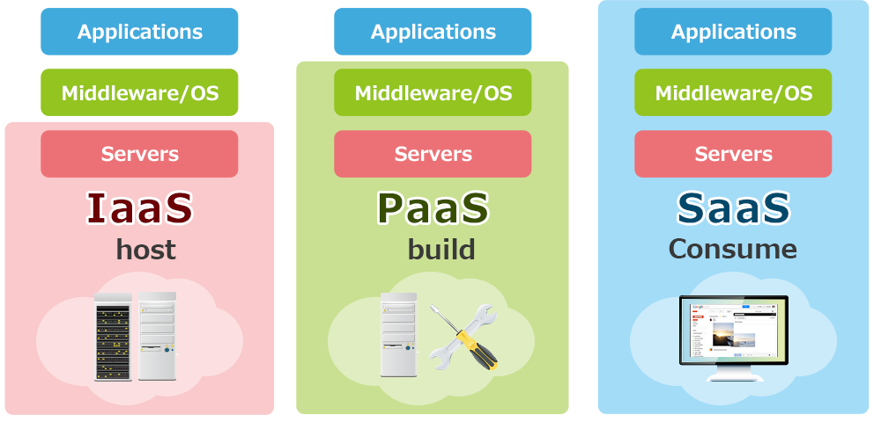
Discussion

Slide 109
Summary
The IaaS model offers the computing resources companies need to host, build and run their services
The PaaS model provides an environment for developers to build and deploy applications
The SaaS model delivers software to users and companies over the Internet
Each cloud service model offers different features and benefits to businesses. Therefore, as we mentioned at the beginning of the article, these three cloud service models are often used simultaneously within companies

